Slide 1
IT1102
Computer Hardware
Week 11
RAM types and their advantages , disadvantages

Slide 2
RAM - Characteristics
  Volatile
    Data loss without electricity
  Mutable
    Read & write
  Random access
    Any location in storage can be accessed in same speed

Slide 3
RAM Types
Static Random Access Memory
  Faster
  Typically used for CPU cache, hard disk buffers, router buffers
  Cost is high

Slide 4
RAM Types
Dynamic Memory
  Memory refresh timely
  Slower than statistic RAM
  Used for main memory

Slide 5
RAM Types
SDRAM (Synchronous DRAM)
  Improved version of DRAM
  Its external pin interface is coordinated by an externally supplied clock signal
  The memory module is synchronized with the clock speed that the microprocessor is optimized for

Slide 6
RAM Types
DDR (Double Data Rate SDRAM)
  Doubles the rate of data transfer of standard SDRAM by transferring data on the up and down tick of a clock cycle.
  Less power consumption
  Less power consumption than early versions
DDR2
  Higher bus speed by running the internal clock at half the speed of the data bus.
  Less power consumption than early versions
  Not backward compatible with DDR memory slots

Slide 7
RAM Types
DDR3
  Higher bus speed
  Less power consumption than early versions
  Not backward compatible with DDR2 memory slots
DDR4
  Higher bus speed
  Less power consumption than early versions
  Not backward compatible with DDR3 memory slots

Slide 8
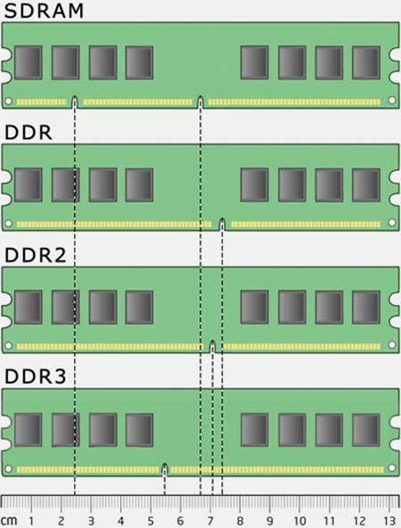

Slide 9
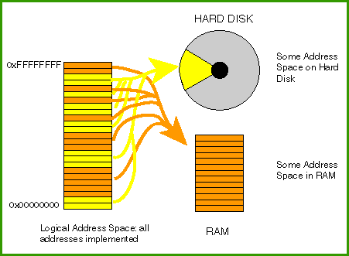
Virtual memory
Not exactly the RAM
Method of extending RAM for running programs capacity

Slide 10
Classroom activity
Group discussion on deferent RAM types available in current market
  Consider their advantages\ disadvantages and their prices

